Slide 1
ELECTRICITY
ZAP!

Slide 2
Which wire provides the MOST resistance?
Wire A
Wire B
Wire C
Wire D
Wire B is the longest.

Slide 3
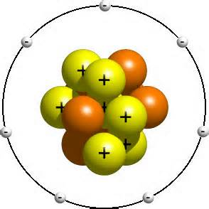
Which parts of an atom are charged?
PROTONS are positively charged. ELECTRONS are negatively charged.

Slide 4
Which wire provides the LEAST resistance?
Wire A : located in a heated garage
Wire B : located inside the home
Wire C : located outside on a cold day
Wire C will have the lowest temperature.

Slide 5
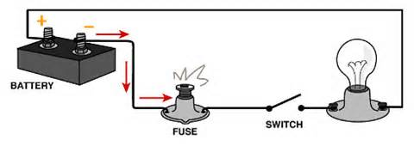
Is the following circuit open or complete?
OPEN. The switch is not closed.

Slide 6
What would happen to light bulb A if light bulb B were unscrewed?
Light bulb A will turn off. *BONUS: Why?
The bulbs are connected in series.

Slide 7
TRUE or FALSE?
The Law of Conservation of Charge states that electrical charges cannot be created or destroyed, only transferred from one object to another.
TRUE

Slide 8
according to the Law of Electric Charge, would the following objects REPEL or ATTRACT?
ATTRACT. These objects have opposite charges.

Slide 9
Which type of circuit would be most useful in homes?
Circuit B because it is hooked up in parallel.

Slide 10
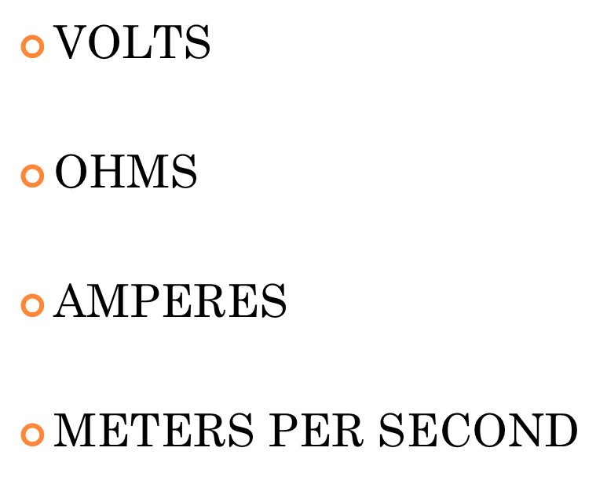
The unit of measure of electrical current is _______________ .

Slide 11
SERIES or PARALLEL?
This type of circuit provides more than one path for electricity flow.
PARALLEL

Slide 12
Name the three components every circuit MUST have.
EVERY circuit must have
an energy source, a load and wires.

Slide 13
TRUE or FALSE?
The Law of Electric Charges states that:
LIKE charges ATTRACT
and
OPPOSITE charges REPEL.
FALSE.
LIKE charges REPEL. OPPOSITE charges ATTRACT.

Slide 14
Which provides the MOST resistance?
Wire A
Wire B
Wire C
Wire A is the thinnest.

Slide 15
SERIES or PARALLEL?
This type of circuit provides only one path for electricity flow.
SERIES

Slide 16
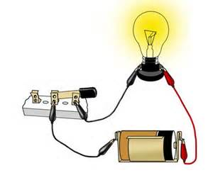
Is the following circuit open or complete?
COMPLETE

Slide 17
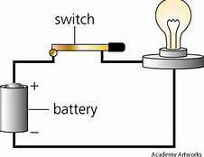
Which letter represents the load in this circuit?
B
B. The light bulb uses electricity.

Slide 18
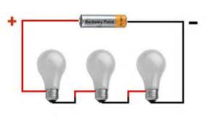
Is the following circuit hooked up in series or parallel?
SERIES. There is one path for electricity flow.

Slide 19
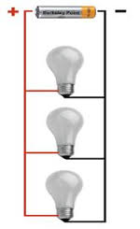
What would happen to light bulb B if light bulb A were unscrewed?
NOTHING.
*BONUS: Why?
The bulbs are connected in parallel. There is more than one path for electricity flow.

Slide 20
Electrical resistance is measured in _______ .

Slide 21
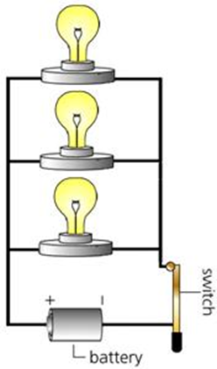
What is missing from the following circuit?
There is NO ENERGY SOURCE.

Slide 22
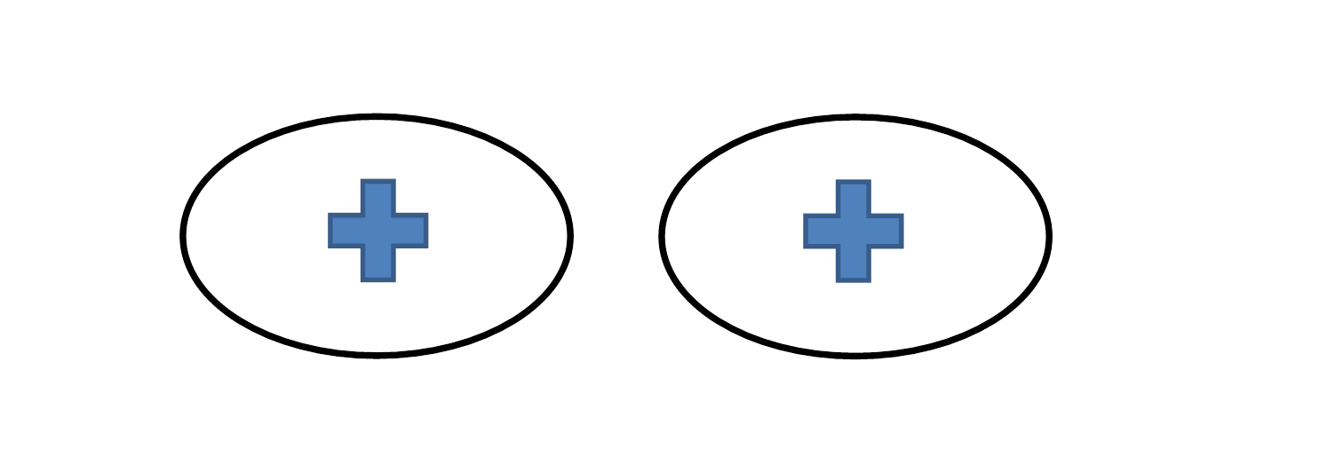
according to the Law of Electric Charge, would the following objects REPEL or ATTRACT?
REPEL. These objects have LIKE charges.

Slide 23
What is the electrical charge of this object: positive, negative or neutral?
NEUTRAL

Slide 24
What would happen to light bulb B if the switch were closed?
battery
Light bulb B would turn on. The circuit would be complete.

Slide 25
Electric FORCE or electric FIELD?
The region around a charged particle that can exert a force (attract or repel) on another charged particle.
ELECTRIC FIELD

Slide 26
according to the Law of Electric Charge, would the following objects REPEL or ATTRACT?
ATTRACT. These objects have opposite charges.

Slide 27
What is the electrical charge of this object: positive, negative or neutral?
POSITIVE

Slide 28
Which of the following are insulators?
Glass
Wood
Copper
Plastic

Slide 29
according to the Law of Electric Charge, would the following objects REPEL or ATTRACT?
REPEL. These objects have LIKE charges.

Slide 30
Which of the following is an example of a LOAD?
Wire
Switch
Battery
Television

Slide 31
Which letter represents the power source of this circuit?
A. The outlet.

Slide 32
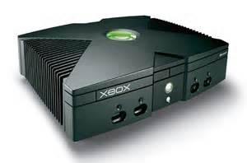
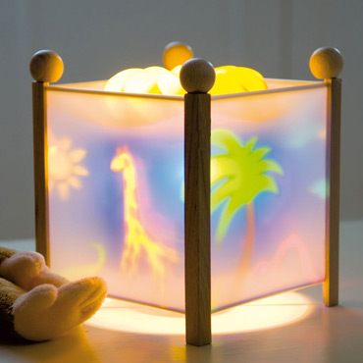
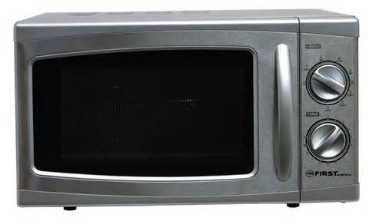
All of the following are examples of which part of an electric circuit?
These are all examples of LOADS, items that use electricity.

Slide 33
GREAT JOB!

