Slide 1
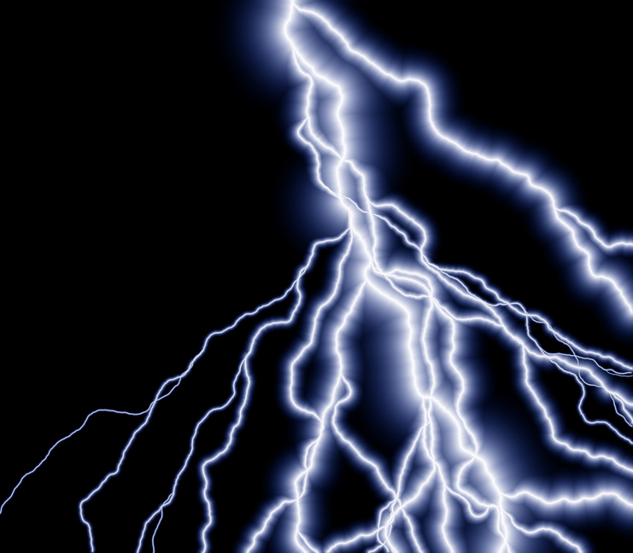
ZAP!
Periodic Table,
Matter,
&
Scientific Method
Review Game

Slide 2
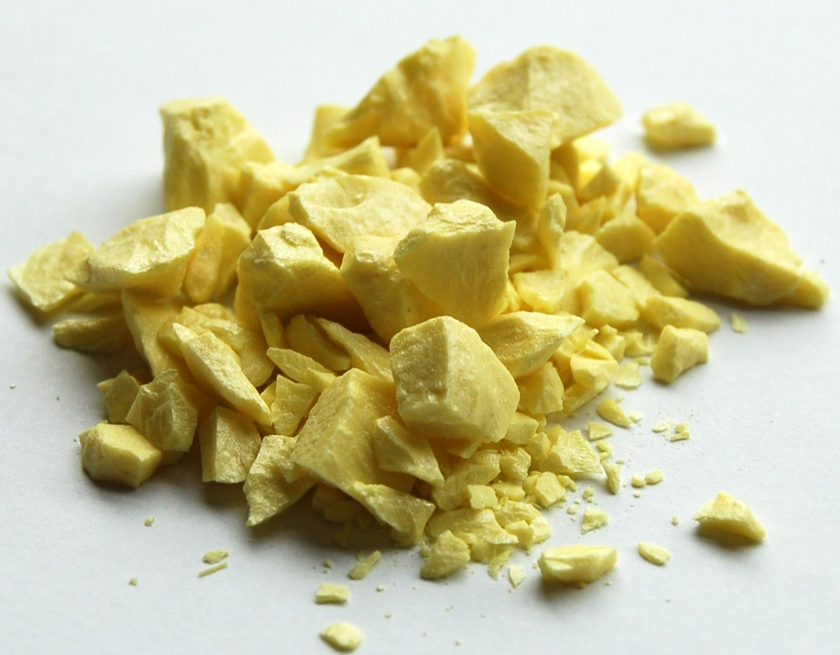
This dull, brittle solid is most likely a METAL, NONMETAL, or METALLOID?
NONMETAL

Slide 3
The ONLY sure evidence of a chemical change is ________________ .
a NEW substance

Slide 4
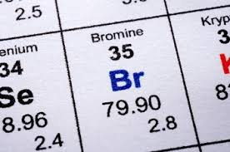
Bromine’s atomic number is 35. This means that bromine atoms will always have 35 ____.
ions
protons
neutrons
valence
electrons

Slide 5
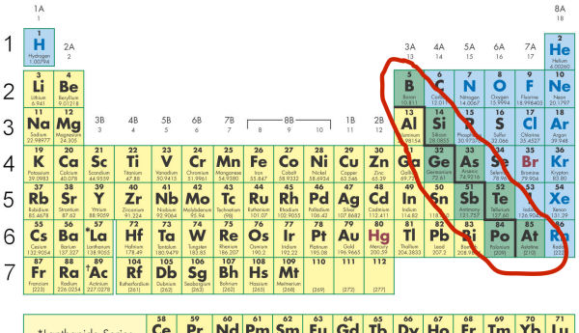
Metals, Nonmetals, or Metalloids?
Hint: These are our semiconductors in electronics
METALLOIDS

Slide 6
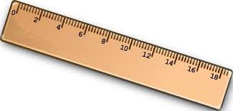
What does a ruler measure?
Length, Mass, or Density?
LENGTH

Slide 7
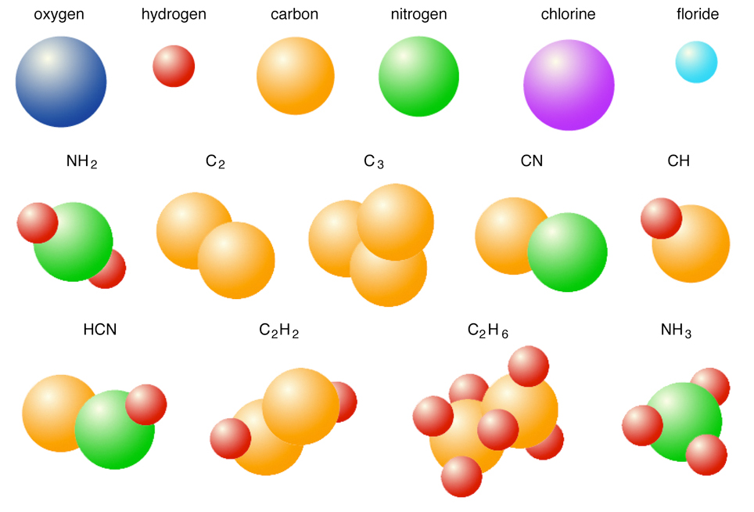
Elements, Molecules, or Compounds?
ELEMENTS

Slide 8
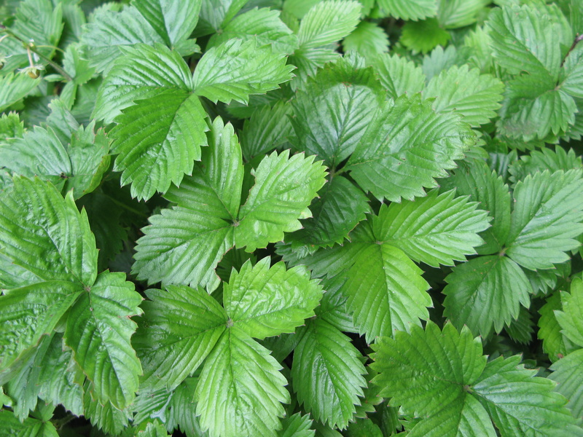
Qualitative or Quantitative Observation?
  “The plant has broad,
  green leaves.”
QUALITATIVE

Slide 9
A cup of hot tea is placed on a scale. Over time, the scale shows that the mass of the tea is decreasing. What is happening?
WATER is evaporating away from the cup.

Slide 10
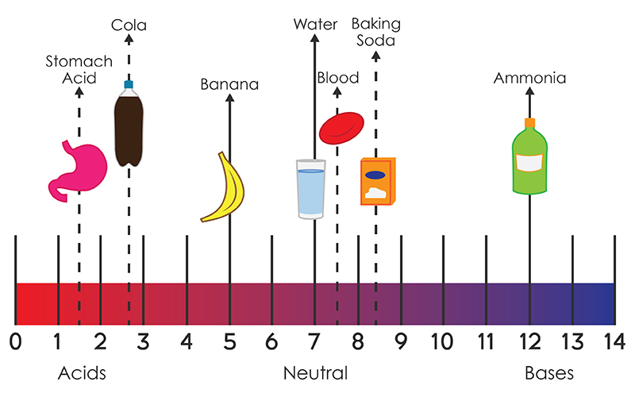
Using the pH scale, which
is the most ACIDIC?
STOMACH ACID

Slide 11
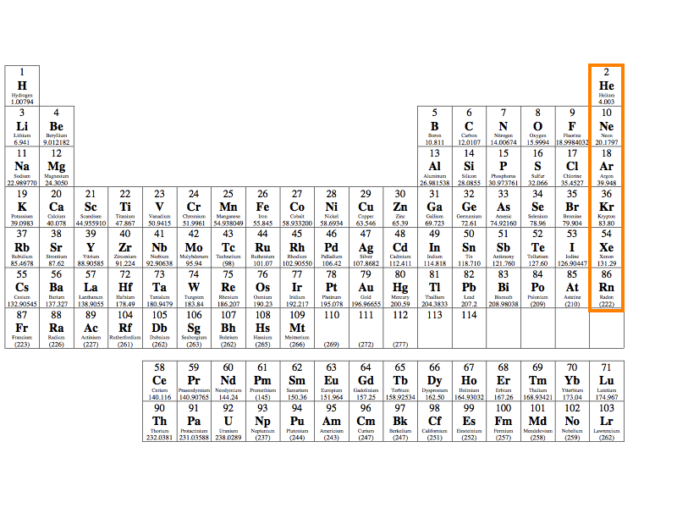
Located in GROUP 18, these elements do not react with others unless they are forced in lab.
NOBLE GASES

Slide 12
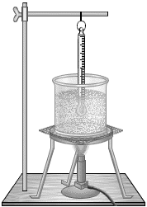
Name three pieces of safety equipment that Andrew needs to use in order to heat up a glass beaker filled with water.
Heat resistant gloves, safety goggles, tongs

Slide 13
Which TWO properties make metal a good choice to use AS WIRE in electronics?
high density conductivity
ductility luster

Slide 14
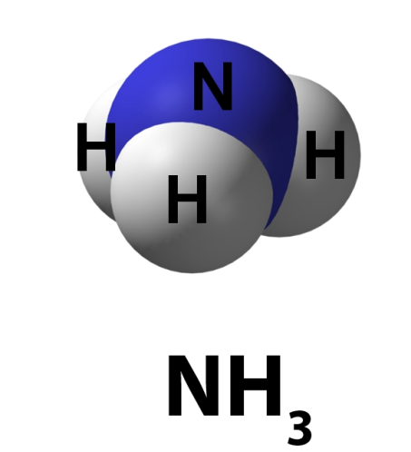
Element, Compound, or Mixture?
COMPOUND

Slide 15
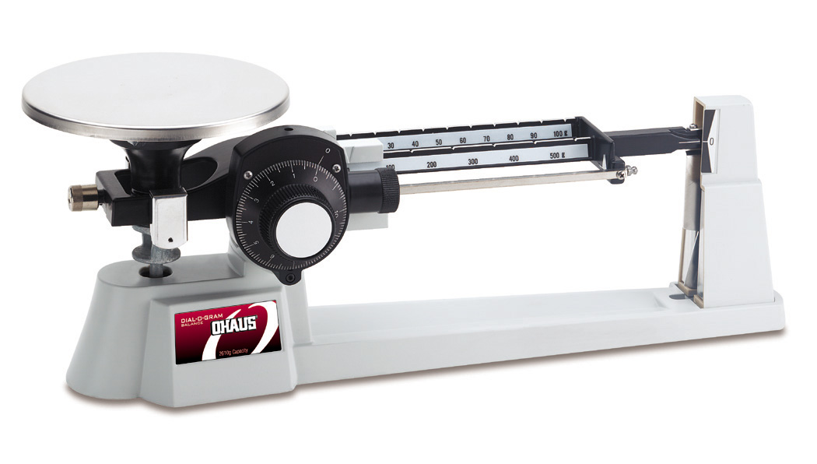
What does a triple beam balance measure?
MASS (weight)

Slide 16
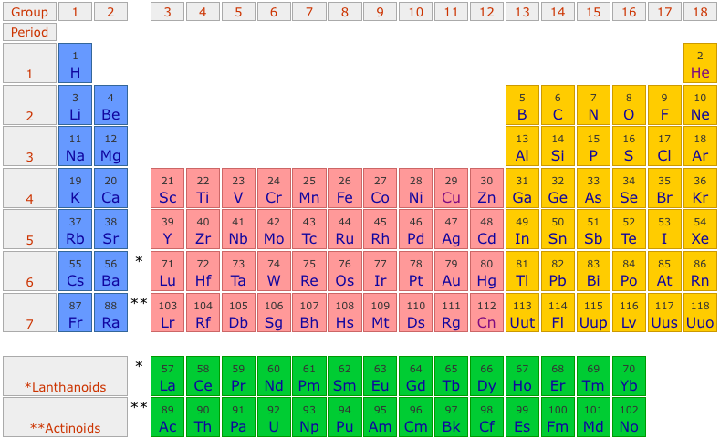
As you move across a period, what happens to the atomic number?
Atomic number increases as you move across the period.

Slide 17
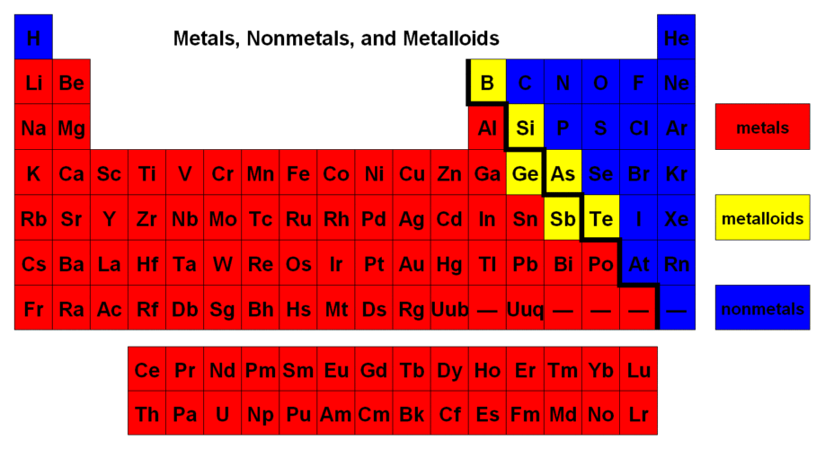
What does the blue color represent on this Periodic Table?
NONMETALS

Slide 18
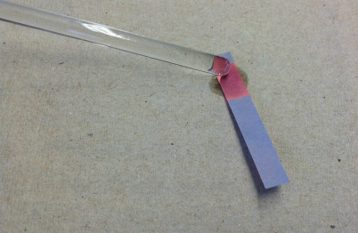
Acid, Base or Neutral?
ACID

Slide 19
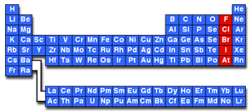
Located in GROUP 17, these elements react quickly with other elements to form salts.
HALOGENS

Slide 20
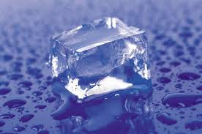
This change of state is an example of
A. basic change
B. physical change
C. extreme change
D. chemical change

Slide 21
What can scientists do to increase the accuracy and reliability of their experiments?
REPEAT THEM!

Slide 22
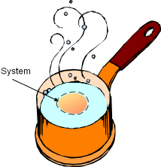
You smell an egg frying in a pan. Which type of system would be observed?
OPEN SYSTEM

Slide 23
Put the following steps of the Scientific Method in order.
A. Form a hypothesis
B. Make a conclusion
C. Perform the experiment
A then C then B

Slide 24
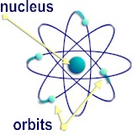
A look inside an atom would reveal a nucleus made up of what kind(s) of particles?
PROTONS and NEUTRONS

Slide 25
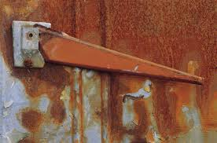
Rusting metal is an example of
  A. a physical change
  B. a chemical change
  C. matter being created
  D. matter being destroyed

Slide 26
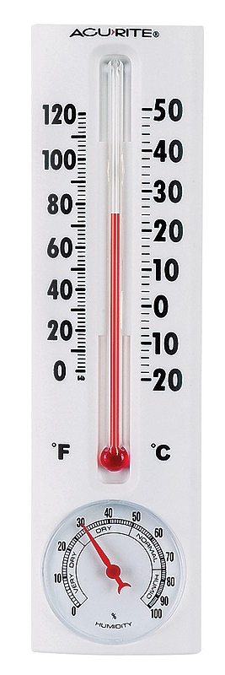
Qualitative or Quantitative Observation?
  “Today’s temperature is four degrees warmer than yesterday’s.
QUANTITATIVE

Slide 27
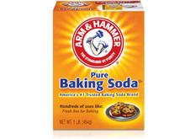
Baking soda has a pH of 8.2 and tastes bitter. This means baking soda is
  A. neutral
  B. acidic
  C. basic
  D. flammable

Slide 28
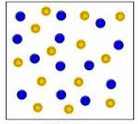
Molecule, Compound, or Mixture?
MIXTURE

Slide 29
Using the pH scale, which
substance is NEUTRAL?
WATER

Slide 30
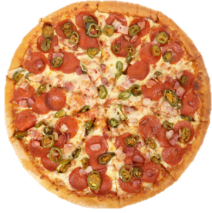
Reese wants to know if the number of toppings on her pizza affects the price she will have to pay.
  What is the dependent variable?
PRICE of PIZZA

Slide 31


If you increase the amount of blood in the water, then more sharks will come.
What is the
independent variable?
AMOUNT OF BLOOD

Slide 32
Using the pH scale, which
is the most BASIC?
AMMONIA

Slide 33
Which of the following is an example of a chemical change?
  A. crumpled paper
  B. a burning log of wood
  C. sugar dissolving in iced tea
  D. a popsicle melting

Slide 34
Which of the following is an example of a physical change?
  A. crumpled paper
  B. a burning log of wood
  C. a lit match
  D. rotting fruit

Slide 35
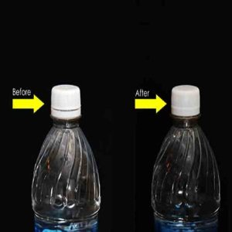
Is this an example of an open or closed system?
AMMONIA

Slide 36
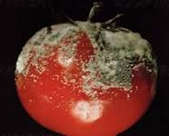
Is this a physical or chemical change?
CHEMICAL

Slide 37
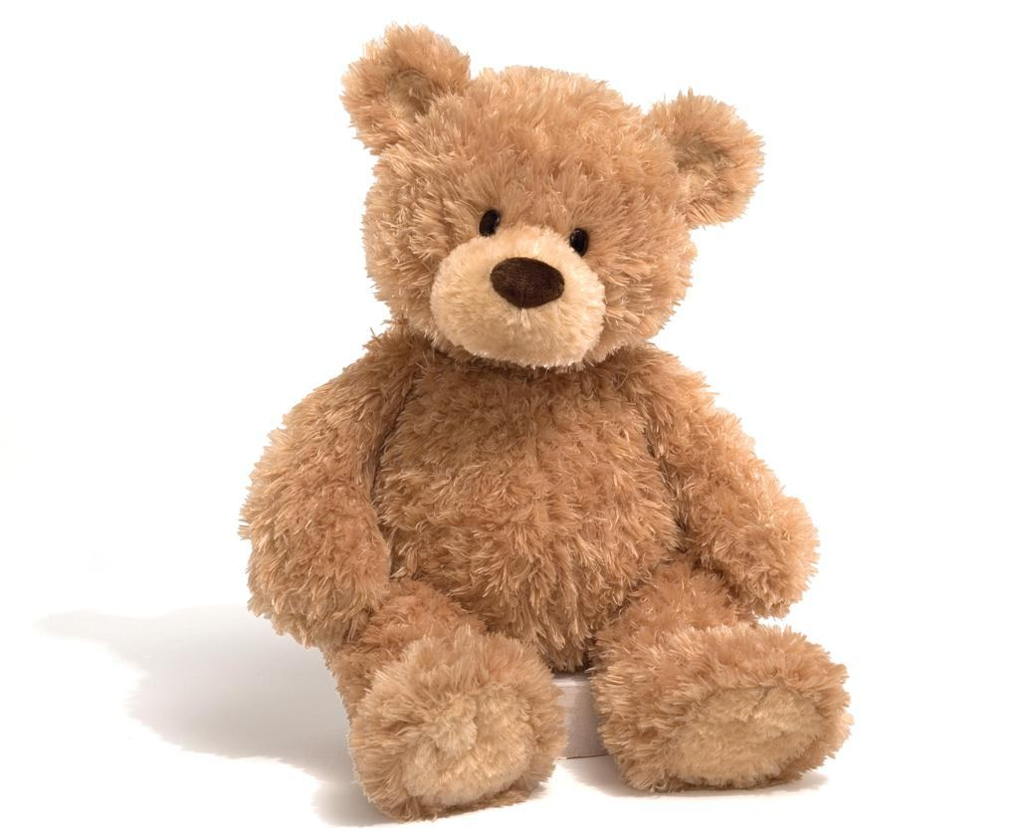
List three physical properties of this object.
BROWN
SOFT
LIGHT
FUZZY

Slide 38
The smallest particle that makes up ALL matter is the _________.
ATOM

Slide 39
Give TWO examples of a PHYSICAL change.
K.I.S.S. METHOD!
RIPPED PAPER
CRUMBLE PAPER
CUT WOOD

Slide 40
Give TWO examples of a CHEMICAL change.
K.I.S.S. METHOD!
BURNT PAPER
DIGESTING FOOD
ROTTING FRUIT

Slide 41
What is a physical property of metal that makes it so useful?
Hint: Think of things we make with metal.
DUCTILITY,
ELECTRICAL CONDUCTIVITY,
MALLEABILITY

Slide 42
Name one CHEMICAL property.
FLAMMABILITY
REACTION TO WATER
REACTION TO ACID

Slide 43
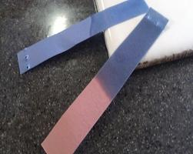
Acid, Base or Neutral?
BASE

Slide 44

Name 2 reasons why scientists must repeat their experiment.
ACCURACY and RELIABILITY

Slide 45
Qualitative or Quantitative Observation?
  “The aluminum ball has a 4.2 inch diameter.”
QUANTITATIVE

Slide 46
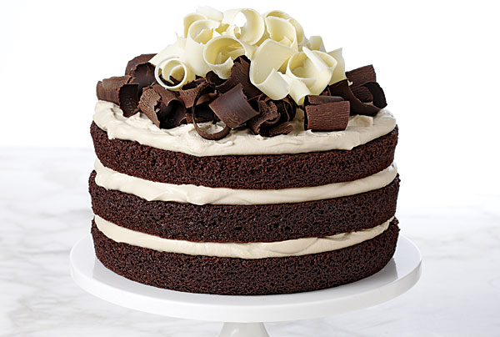
Jenny thinks that applesauce makes cake more moist than oil.
  What scientific question could she use as her experiment’s problem?
Does applesauce make cake more moist than oil?

Slide 47

Which scientist’s results would be most accurate and reliable?
Scientist #1 | Scientist #2 | Scientist #3
repeated the experiment and obtained different results each time | paid for the experiment to be done and published the results | repeated the experiment and obtained the same results each time
Scientist #3

Slide 48
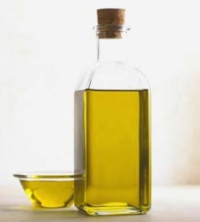
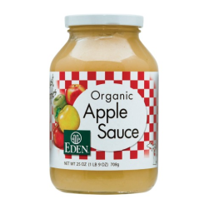
Jenny thinks that applesauce makes cake more moist than oil.
  Using Jenny’s problem, and knowing that she usually uses oil in her cakes, which cake would be the experimental group?
The cake made with applesauce is the experimental cake.

Slide 49
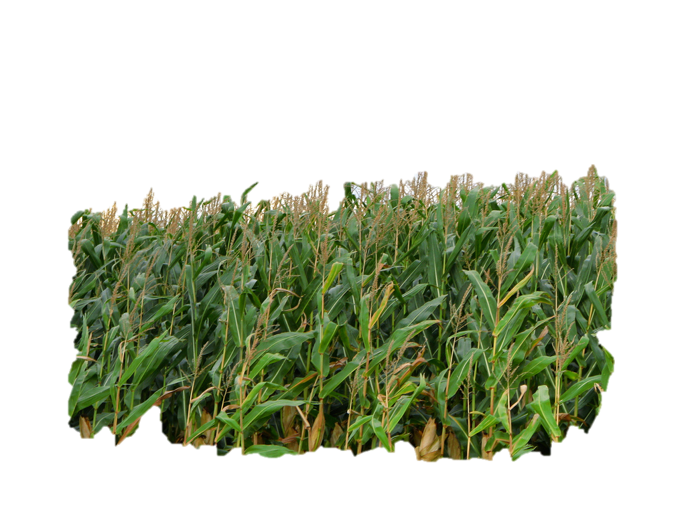
George wonders if Super Grow fertilizer will make his corn grow faster than normal.
What is the independent variable George is testing?
IV: fertilizer

Slide 50
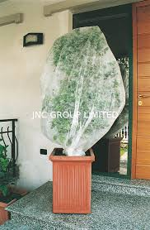
Two students are studying the effect of insects on plant growth. They prevent insects from eating some plants by covering the plants with a transparent mesh cloth. The students leave the other plants uncovered.
What are some of the constants in their experiment?
Amount of light
Amount of water
Type of plant
Type of pot/soil

Slide 51
Jack thinks that the volume of cricket chirping outside his window has something to do with the temperature outside.
  What part of the Scientific Method did he just complete?
“Chirp”
“Chirp”
Form a hypothesis.

Slide 52

Willow is graphing the results of her experiment.
  This is an example of which step of the Scientific Method?
Analyze/Interpret data

Slide 53
Beth measures the mass of the mice in her lab everyday for 14 days and writes the measurements in her table.
  This is an example of which step of the Scientific Method?
Observe and record data.

Slide 54
Which of the following is a good scientific question?
  Who is cooler, Albert Einstein or Isaac Newton?
  Which insect produces the most honey?

Slide 55
Name one of the five skills of good scientists?
Observing
Inferring
Predicting
Classifying
Making Models

Slide 56

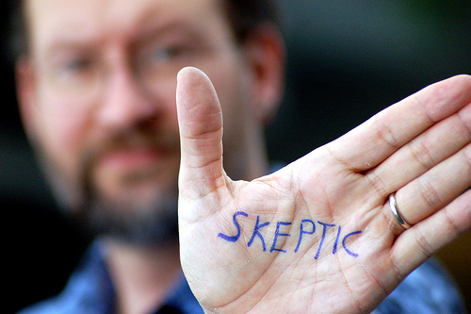
Describe the attitude of “skepticism.”
An attitude of DOUBT

Slide 57
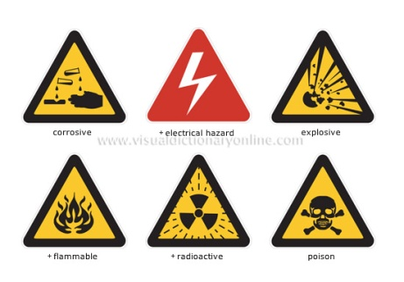
Pick one symbol. Describe what it tells you about the experiment.
Electric Shock
Corrosive Chemical
Explosive
Flammable
Radioactive
Poisonous

Slide 58
Explain why the following question is NOT a good scientific question.
Are green beans better for you than carrots?
“BETTER” is an opinion and can not be measured.

Slide 59
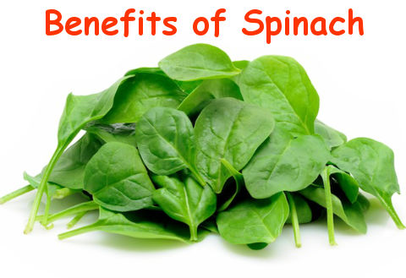
Kyle wonders if eating spinach will make him a better basketball player. Which of the following should he use for his experiment’s problem?
Does eating spinach make you better at basketball?
Does eating spinach improve shooting accuracy?

Slide 60
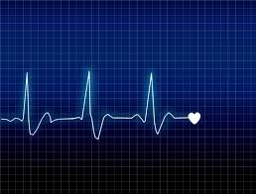
A scientist is studying the effects of sleeping pills on a person’s heart rate. What is something that should be kept constant?
Sleeping conditions
Amount of sleeping pills
Initial heart rate
Health of test subject
# of test subjects per group

Slide 61
What is the definition of data?
Any information gathered during an experiment

Slide 62
Which of the following means “an eagerness to learn more”?
A. skepticism
B. creativity
C. honesty
D. curiosity
E. open-mindedness

